Slide 1

The Spirit Controlled Church & It’s Members
EPHESIANS 5:18-21
And be not drunk with wine, wherein is excess; but be filled with the Spirit; 19 Speaking to yourselves in psalms and hymns and spiritual songs, singing and making melody in your heart to the Lord; 20 Giving thanks always for all things unto God and the Father in the name of our Lord Jesus Christ; 21 Submitting yourselves one to another in the fear of God.

Slide 2

Birthdays
Jan. 12th Jessie Cockman
Jan. 13th Lincoln Clayville
Jan. 14th Hans Florian, William Cross
Jan. 15th Jaci Whitlock, Peyton Botha
Jan. 18th Communion
Feb. 28th Anniversary Meeting

Slide 3
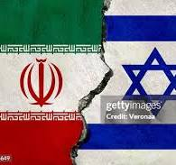
“Prime Minister Benjamin Netanyahu declared his aim to taper off Israeli reliance on American aid within a decade…For the first time in public, Netanyahu revealed that he may not seek to fully renew the $3.8b American military assistance package that Israel receives annually. The package is due for renegotiation in 2028.”
https://www.jpost.com/israel-news/politics-and-diplomacy/article-882871

Slide 4
BUT.IT.WASN'T.SO.FROM.THE.BEGINNING
104 Jesus Christ, stands not two foot from where I am now, same Light. And I take every spirit in here under the control of the Holy Ghost for the glory of God. Be quiet. Don't move, because demons go from one to another. And we know that.
If you won't come then say nothing evil against it from henceforth 'cause you'll be blaspheming the Holy Ghost and send your soul to torment without mercy.
61-0411

Slide 5
UNITY.ONE.GOD.ONE.CHURCH
71 That little compartment in a man's heart, God made that in there for Himself. That's His control room. He sets there to control you. That's His place. That's where He sends His messages from.
How can He work with you when the nature of the spirit of the Devil is there? And every man born on earth is borned in sin, shaped in iniquity, come to the world speaking lies. So, in that carnal Adamic nature, how can a man achieve anything, only through

Slide 6
his intellectuals? But when he comes to be a new creature, the old man has passed out, and the new Man, Christ, takes His throne in the human heart, then life looks different; he starts on a new road from his own selfish motives, till the big ideas to make himself something big, he starts right towards Calvary to recognize God.*
Then his objective, motive, achievement, and all that he is, lays in the glory of the cross, where Christ paid the price for human life. 58-1221

Slide 7
EPHESIANS 5:18-21
And be not drunk with wine, wherein is excess; but be filled with the Spirit; 19 Speaking to yourselves in psalms and hymns and spiritual songs, singing and making melody in your heart to the Lord; 20 Giving thanks always for all things unto God and the Father in the name of our Lord Jesus Christ; 21 Submitting yourselves one to another in the fear of God.

Slide 8

TITUS 1:6
If any be blameless, the husband of one wife, having faithful children not accused of riot [prodigality] or unruly.

Slide 9
Plus: 1. Healing for the Body
2. Healing for the Spirit
LUKE 17:20-21
And when he was demanded of the Pharisees, when the kingdom of God should come, he answered them and said, The kingdom of God cometh not with observation: 21 Neither shall they say, Lo here! or, lo there! for, behold, the kingdom of God is within you. (already among you.)
Revelation from the Father
Body
Spirit
Soul

Slide 10
CHRIST.IS.IDENTIFIED.THE.SAME
IN.ALL.GENERATIONS
71 He's Eternal, and He's the only source of Eternal Life… Now, therefore, if we have Eternal Life, we have part of God in us... Then, that's the only way you could have Eternal Life. It isn't something that was manufactured, then given to you by some creed, or you lived into it, you grew into a better man or a better woman.
It's God Himself in you. Just like you're a part of your father here on earth; you're a part of your Heavenly Father.
64-0415

Slide 11
How could this
be possible?
“For the Holy Ghost is Jehovah in Spirit form in you.”

Slide 12
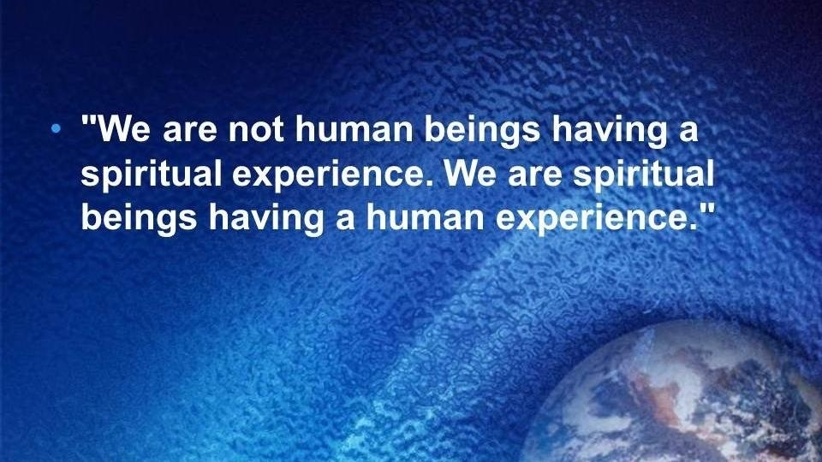

Slide 13
What are the characteristics
of that Church?

Slide 14

I JOHN 1:1-3
That which was from the beginning, which we have heard, which we have seen with our eyes, which we have looked upon, and our hands have handled, of the Word of life; 2 (For the life was manifested, and we have seen it, and bear witness, and shew unto you that eternal life, which was with the Father, and was manifested unto us;) 3 That which we have seen and heard declare we unto you, that ye also may have fellowship with us: and truly our fellowship is with the Father, and with his Son Jesus Christ.

Slide 15
ISAIAH 11:6-7, 9-10
The wolf also shall dwell with the lamb, and the leopard shall lie down with the kid; and the calf and the young lion and the fatling together; and a little child shall lead them. 7 And the cow and the bear shall feed; their young ones shall lie down together: and the lion shall eat straw like the ox.
…9 They shall not hurt nor destroy in all my holy mountain: for the earth shall be full of the knowledge of the LORD, as the waters cover the sea. 10 And in that day there shall be a root of Jesse, which shall stand for an ensign of the people; to it shall the Gentiles seek: and his rest shall be glorious.

Slide 16
SIXFOLD.PURPOSE.OF.GABRIEL’S.
VISIT.TO.DANIEL
100 Habakkuk 2. [Isaiah 11:6] We're going to see why He sealed up this old serpent, what it was done for, and what takes place immediately after he is sealed up. “For the earth shall be filled with the knowledge and the glory of the LORD…” In other words, when the enemy has been put away, the end of sin has come, the bringing in of everlasting

Slide 17
HABAKKUK 2:14
For the earth shall be filled with the knowledge of the glory of the LORD, as the waters cover the sea.

Slide 18
MATTHEW 22:15-22
Then went the Pharisees, and took counsel how they might entangle him in his talk. 16 And they sent out unto him their disciples with the Herodians, saying, Master, we know that thou art true, and teachest the way of God in truth, neither carest thou for any man: for thou regardest not the person of men. 17 Tell us therefore, What thinkest thou? Is it lawful to give tribute unto Caesar, or not? 18 But Jesus perceived their wickedness, and said, Why tempt ye me, ye hypocrites?

Slide 19
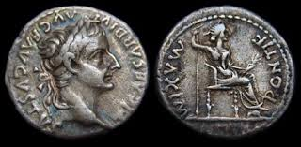
Tiberius Caesar Divi Augusti Filius Augustus
Translation: "Tiberius Caesar, Son of the Divine Augustus"

Slide 20
19 Shew me the tribute money. And they brought unto him a penny. 20 And he saith unto them, Whose is this image and superscription? 21 They say unto him, Caesar's. Then saith he unto them, Render therefore unto Caesar the things which are Caesar's; and unto God the things that are God's. 22 When they had heard these words, they marvelled, and left him, and went their way.

Slide 21
ROMANS 1:1-7
Paul, a servant of Jesus Christ, called to be an apostle, separated unto the gospel of God, 2 (Which he had promised afore by his prophets in the holy scriptures,) 3 Concerning his Son Jesus Christ our Lord, which was made of the seed of David according to the flesh; 4 And declared to be the Son of God with power, according to the spirit of holiness, by the resurrection from the dead: 5 By whom we have received grace and apostleship, for obedience to the faith among all nations, for his name: 6 Among whom are ye also the called of Jesus Christ: 7 To all that be in Rome, beloved of God, called to be saints: Grace to you and peace from God our Father, and the Lord Jesus Christ.

Slide 22
BIRTH.PAINS
111 Moses could not have brought Noah's message. Neither could Jesus have brought Noah's message, because it was another age. And the old seed was right, it served its purpose, dead and gone on. The transformation from the old to the new, where the Life was at, was worrying the people, what worries them yet today. We're not building a wall, like we start off with Luther's message, go right down a straight line, or a Pentecostal message.

Slide 23
We are turning corners. We're building a building. God's Word is the blueprint. Anybody can run a straight line, but it takes a mason to turn the corner. It takes the power of God to do that. Takes an anointed one from Heaven, to be sent down to do that.
And in the prophets' age, the Word of the Lord comes through those prophets, and they turn those corners... But the builders wanted to build a wall. It's not a wall, at all. It's a building, a building of God.
65-0124

Slide 24
**CHRIST.IS.REVEALED.IN.HIS.OWN.WORD
151 [The forming of the Body through the Ages] The Church took His place, martyrdom and Dark Ages… Then where does the sight come from? At the top of the head. Now it's in the head time. You can't see with your hands, the ears, nose, lips, though it speaks: that was the Pentecostal age. But now it's in the eye time, the seeing. There isn't one moving faculty beyond the eye. The next is the intelligence, which is Christ Itself, Who controls the whole Body. No moving, motion beyond that. Everything else has moved. Move your feet, legs, move everything. But after your eyes, there is nothing moves.

Slide 25
That's why man get baldheaded quick is because there's no exercise to develop the muscles in the scalp.
[Zech. 14:6-7] Compare it with Mal. 4, Luke 17:30, "As it was in the days of Sodom..." So there can't be no organiza-tion left, neither can there be any further advancement than what's going right now, she'll burn before day breaks again. The revival is over, across the nation. There ain't going to be no more… big sweeping revivals. You might have a intellectual gathering. But, a Spiritual revival, we've seen all of it. A fine minister said, a while ago, said, "Bro. Branham, if I could just have the joy of the Lord in my heart!" I said, "Son, the revival is over."

Slide 26
156 Now the stabilizers has been put on the ship. Great fearful waves are before us; but just beyond that wave we're nearing the shore. Stay stable, stay in the Word. Stay with God. No matter how you feel, stay right with the Word. When you see all these great big clouds around us, storms coming, atomic bombs, everything else they're talking about. But our stabilizer is right straight in the Word. God said it would be here; we'll crest every one of them. They, they can't sink us…can't drown us. You put us in the grave; we'll come out again. Ain't no way in the world to keep it down there. We'll crest every one of them, 'cause our great Chief Captain is calling at the other side. 65-0822

Slide 27


Slide 28
SPIRITUAL.AMNESIA
29 You must be identified… either in Christ or out of Christ. You are not halfway. There's no such a thing as a drunk sober man.
You're either a saved, or you're not saved. You're a saint or a sinner, one or the other. And your spiritual attitude towards God's Word identifies you, exactly where you're standing.
64-0411

Slide 29
QUESTIONS.AND.ANSWERS.2
318. What is the evidence that a person is really filled with the Holy Ghost?
John 14:26: "When the Holy Ghost is come, He will show you things to come." When He the Holy Ghost is come, He will identify Himself in you with the Scripture. And that is the true sign that the Holy Spirit is in you, because It is the Word.
What if you spoke with tongues? I just want to ask you that. Jesus said when the Holy Ghost come

Slide 30
what He would do. What if you spoke with tongues, jumped up-and-down, shouted, then come to the Word; and I'd prove to you by the Scripture, that the baptism using the title of Father, Son, and Holy Ghost is absolutely a misunderstanding in the Scripture; nobody was ever baptized like that, and you go ahead and hang with it anyhow?
Could you tell me the Holy Spirit in you would do a thing like that? How can It deny It's own Word?
64-0823

Slide 31
THE.MARRIAGE.OF.THE.LAMB
138 The first thing you know, we got to have a building that's so big it's got to outshine the Methodists... "We belong to the first church," look down upon them.
139 What you need is the Holy Ghost, to deflate you a little bit, let you know that the real true baptism of the Holy Ghost will make a tuxedo suit put his arms around a pair of overalls and say, "brother." Real old-time salvation, the power of Almighty God will make an old silk dress put its arms around a calico, say, "Sister, I love you." Sure will. 62-0121

Slide 32

The "test" for spiritual experiences:
If someone claims the Spirit told them to do something that violates a Biblical command (like being dishonest), they can be sure it was not the Spirit of truth, because the Spirit always aligns with God's revealed truth.

Slide 33
WHY
20 And we put a gospel meeting here, Jesus Christ comes in Presence with us to bless us, and we'll just get a handful out of the city. What is it? "No man can come to Me except My Father draws him first." I feel it's the cream of the crop, the elected. "My sheep hear My voice, and a stranger they don't follow." Depends on what's on the inside of you drawing. It's the elect always that God speaks to and sends His message to. 60-0309

Slide 34
CHURCH.AGE.BOOK
155-1 We have been constantly saying the true evidence of being baptized with the Holy Ghost is for the believer to receive the Word for the age in which he lives. In every single age, it says "... He that hath an ear..." Notice that Jesus in EVERY age addresses Himself to ONLY ONE person relative to the Word for that age. ONE messenger for each age receives what the Spirit has to say to that age. He speaks for God by revelation to the "churches", both true and false.

Slide 35
The message is then broadcast to all. But though it is broadcast for all who come within range of the message, that message is received individually by only a certain qualified group in a certain way. Each individual of that group is one who has the ability to hear what the Spirit is saying by way of the messenger. Those who hear are not getting their own private revelation, nor is a group getting their collective revelation, BUT EACH PERSON IS HEARING AND RECEIVING WHAT THE MESSENGER HAS ALREADY RECEIVED FROM GOD.

Slide 36
I CORINTHIANS 15:53
For this corruptible must put on incorruption, and this mortal must put on immortality. 54 So when this corruptible shall have put on incorruption, and this mortal shall have put on immortality, then shall be brought to pass the saying that is written, Death is swallowed up in victory.

Slide 37
MANIFESTED.SONS.OF.GOD
And Christ brought the church up to the place to where their possession was given to them, just the Jordan to cross, but the Holy Spirit is the One Who sets the church in order, the Joshua of today puts the church in its order, giving to each one, gifts, places, position. And He is the Voice of God speaking to the inner man that Christ has saved: the Holy Spirit. 60-0518

Slide 38
CHURCH.AGE.BOOK
336-4 This New Creation is not the old creation made over, or it could not be called a new creation. It is another creation, distinct from the old one. No longer is He dealing by ways of the flesh… Now by His Spirit He is creating many Sons unto Himself. God the creator, creating Himself a part of His creation. This is the true revelation of God. This was His purpose. This purpose took form through election.

Slide 39
HEAR.YE.HIM
37 And the great Full Gospel church has become nearly a floor show. You've got so much Hollywood evangelism. God help us to tear that thing from the pulpit and get back to the Word of God and the true baptism of the Holy Spirit. We need it. 57-0322

Slide 40

JOHN 20:22
And when he had said this, he breathed on them, and saith unto them, Receive ye the Holy Ghost:
LUKE 24:49
And, behold, I send the promise of my Father upon you: but tarry ye in the city of Jerusalem, until ye be endued with power from on high.

Slide 41
QUESTIONS.AND.ANSWERS.4
383. Bro. Branham, what is the difference when Jesus breathed on the disciples and said, "Receive ye the Holy Ghost," and when they had to go to the upper room to tarry?
It was a promise He gave them, breathed upon them His promise, said, "Receive ye the Holy Ghost." It was a promise. They went to the upper room to wait for the promise to be fulfilled. The same thing is when we lay hands upon you to be healed, then you go on about your business waiting for the promise to be fulfilled.
64-0830

Slide 42
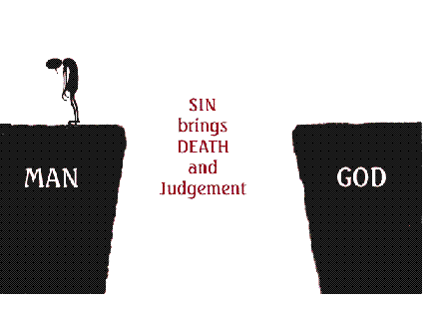

Slide 43

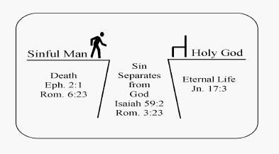

Slide 44

THE.RESULTS.OF.DECISION
38 I said, "The Sabbath is the Holy Ghost. It was at one time limited to a certain people, but today the Sabbath is the baptism of the Holy Ghost.” He said, "Oh, it can't be. God gave the day and sealed it with a memorial that it was a day keeping."
I said, "For a people, but today Eph. 4:30 said, 'Grieve not the Holy Spirit of God whereby you're sealed till the day of your redemption.’
55-1008

Slide 45
THE.TOKEN
153 When God has give you the true baptism of the Holy Spirit, then the Life of Jesus Christ is within you… It's the new Birth. And because God has did this, you know you're no good in yourself, you accept what God has did, then He seals you into His Kingdom, by the Holy Spirit. Everything that Jesus purchased and promised you, in the Bible, is yours. It's your property because it's paid for. Life is mine; Life is

Slide 46
yours; Healing is mine; He paid for it. Freedom is mine; Heaven is mine… Everything He purchased belongs to the man that holds the Token. Amen. “On that Day of the Judgment I'll pass over you." Holding your confession in the Word, that Jesus Christ has died for you. And when He does it, He displays Himself through you. 63-1128

Slide 47
WHAT.SHALL.WE.DO.WITH.THIS.JESUS.
The evidence... Luther said, "Believe, and walk out." The devil believes, too…
When that spirit that's in you can punctuate every promise with an amen, and God will confirm it. That's exactly the way it was with Jesus Christ. They had more fruits of the spirit, all kinds of evidences. You can't pin any evidence down to anything but God Himself manifesting His Word. That's the only true evidence that there is that you're a Christian. 64-0126

Slide 48
64-0719 THE.FEAST.OF.THE.TRUMPETS
102 Righteousness, you can't pronounce that just "going to church" is the evidence of the Holy Ghost. If you do, then them Pharisees had It. See? You can't pronounce "shaking or jumping" being the... If you do, the heathens has got It. If you say "speaking in tongues," what--what devil worship doesn't speak in tongues? Tell me one.
Brother Jackson setting here for Africa, from Africa, he could tell you that. I've been into the Indian camps here, see the witches and wizards cut themselves, and pour their own blood, and speak in tongues; and--and the witch doctor interpret it, and see them lay down a pencil and write in unknown tongues. So that's not It. But if it...
103 What is the true evidence? Jesus said, "That you believe that I am He." And He is the Word.

Slide 49
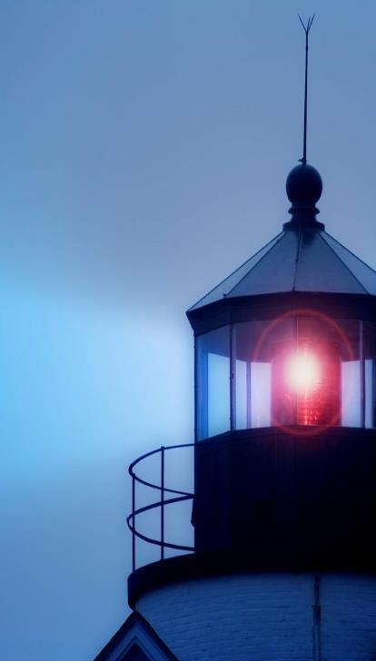
“…at evening time it shall be light.”
I JOHN 1:7
But if we walk in the light, as he is in the light, we have fellowship one with another, and the blood of Jesus Christ his Son cleanseth us from all sin.

