Slide 1
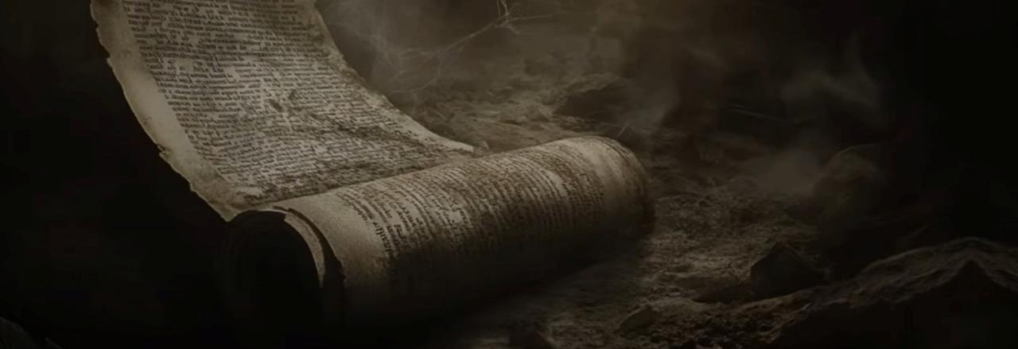
Thy Word: How to Study Your Bible
II TIMOTHY 2:15
Study to shew thyself approved unto God, a workman that needeth not to be ashamed, rightly dividing the word of truth.

Slide 2
THE.SPOKEN.WORD.IS.THE.ORIGINAL.SEED.
378 David said, "Thy Word have I hid in my heart, that I sin not against You, Lord." Only thing he needed was the rain. David would have been all right if he could just had that rain, but the Holy Ghost wasn't yet given. He had the Word, and the Word was in him, and he could know It. He said, "I've hid It in my heart, Lord. It won't bloom out and act like It should, but I've hid It there, Lord. I've hid It there."
62-0318

Slide 3
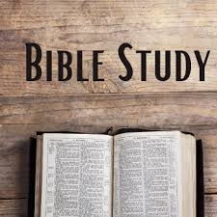
REMEMBERING.THE.LORD
144 Jesus said, "Why do you call Me 'Lord,' and do not the things that I tell you to do?" We ought to study the Scripture. We ought to find out what God's program and plan is. He said, "You call Me 'Lord,' when you don't do the things that I command you to do?“ 63-0122

Slide 4
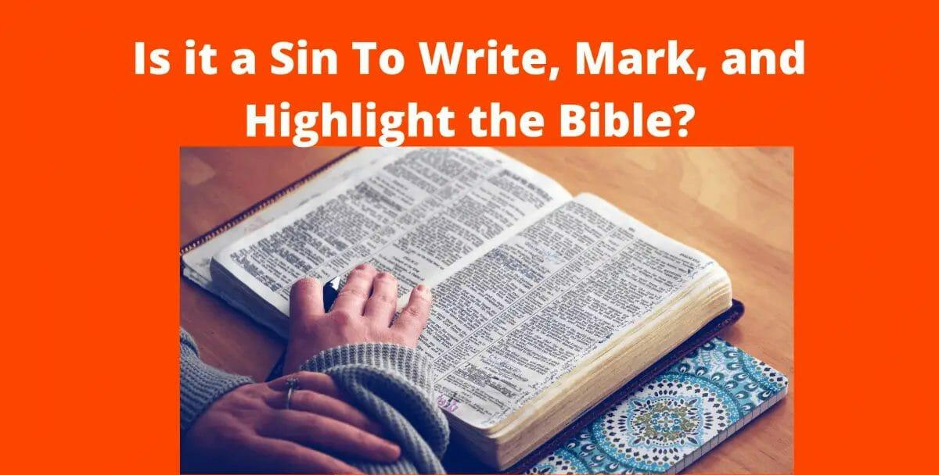

Slide 5
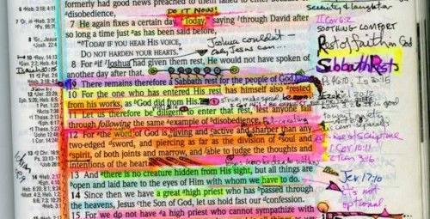

Slide 6
GOD.HIDING.HIMSELF.IN.SIMPLICITY
124 Now, study that. Study it all. And you people who are visiting here, when you go to your motel rooms, take those things and ponder over them. We don't have time to break it down as it should be broke down, but I want you to do it when you get to the motel, or hotel, or wherever you're staying, or the home.
63-0317

Slide 7

JOHN 16:13
Howbeit when he, the Spirit of truth, is come, he will guide you into all truth: for he shall not speak of himself; but whatsoever he shall hear, that shall he speak: and he will shew you things to come.

Slide 8
GOD.TESTIFYING.OF.HIS.GIFTS
11 I want to read a Scripture every night, I hope that you in your home, will read at least one chapter in the Bible every day and pray. Always do that. That's the old- fashion Christian home, and God knows that we need more of that, more than we need atomic bombs, in America. That would be the best thing that we could have, was a fortress of God's love and power around us. 52-0713

Slide 9


Why Should I study my bible?
I CORINTHIANS 14:34
Let your women keep silence in the churches: for it is not permitted unto them to speak; but they are commanded to be under obedience, as also saith the law.
DEUTERONOMY 22:5
The woman shall not wear that which pertaineth unto a man, neither shall a man put on a woman's garment: for all that do so are abomination unto the LORD thy God.
Gender Identity?
Women’s Hair?

Slide 10
SPIRIT.OF.TRUTH
29 God can raise up a little something different, and altogether we denounce it. Instead of searching Scripture to see if it's right or not, we quickly throw it away, "There's nothing to it." We ought to search out these things, find out whether they're right or not. And if they're not right, they'll finally die, for Jesus said, "Every plant that My Heavenly Father has not planted will be rooted up."
30 Gamaliel made that great statement, "If it be of God, we don't want to be found fighting against It. And if it's not of God, it'll come to naught anyhow." So, study it and think of it.
63-0118

Slide 11
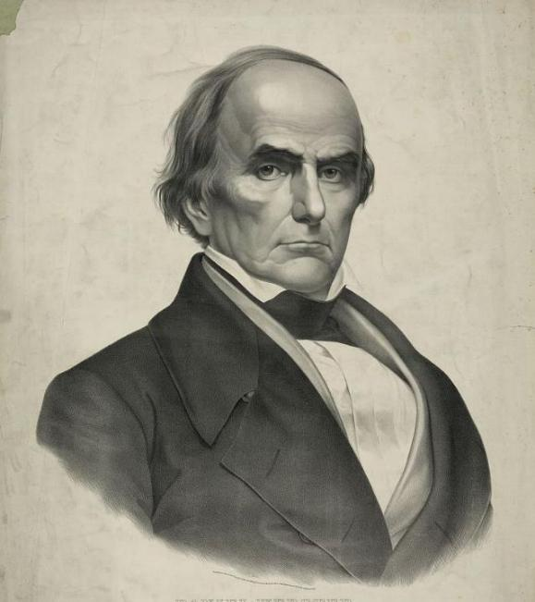
Daniel Webster
“If there is anything in [me] to commend, the credit is due to my parents for instilling in me an early love of the Scriptures.
If we abide by the principles taught in the Bible, our country will go on prospering and to prosper; but if we and our posterity neglect its instructions and authority, no man can tell how sudden a catastrophe may overwhelm us and bury all our glory in profound obscurity.”

Slide 12

Women’s Hair:
I CORINTHIANS 11:1-16; 14-16
Doth not even nature itself teach you, that, if a man have long hair, it is a shame unto him? 15 But if a woman have long hair, it is a glory to her: for her hair is given her for a covering. 16 But if any man seem to be contentious, we have no such custom, neither the churches of God.

Slide 13
THE.MARK.OF.THE.BEAST
8 Now, this great subject that we are approaching has certainly caused some great controversy and some pro and con on the subject. And I myself believe it's such a great, vital part of the Scripture, that all the Scripture should be taught: all of it. We should not leave any of it out.
God has spoke through the Scriptures about the mark of the beast and how that it was to appear in the last days. And as a minister of the Gospel, believing that we're living in the last days. I believe that it's a timely message that should be approached reverently in this day. 56-0715

Slide 14
THE.UNVEILING.OF.GOD
137 That [God on the mountain] was so great till even the people said, they said when they seen Jehovah come down in this Pillar of Fire, begin to shake the earth, and the things He done, and the mountain on fire. What about This Glory?
If that was veiled by a natural veil, this is veiled by a spiritual veil. So don't try to look at the natural; break into the Spirit and see where you're at, see what hour we're living in. 64-0614

Slide 15
Our Beliefs:
Facts; Personal Experiences;
Experiences of Others that we Trust;
Revelation.
“You don't know God by intellectual conception. You know God by faith... you can't explain it. No one can. God is without finding out by explanation; you've got to believe Him; it wouldn't be a faith no more.“ INVESTMENTS 63-0803

Slide 16
THE.PROPHET.ELISHA
10 Sometimes we go off on a tantrum somewhere and not think about God, not pray over it… Then we wonder, "Well, wonder why I can't have no more blessings." You don't watch, you let down in your prayer life. You say, "Well, I'm a Christian." Well, that's the more sign you should pray, more than ever. Read the Bible every day. Pray every day. Don't make any

Slide 17
decisions too harshly or too quickly, without first considering God about it. "Shall I do this, Father?" Ask Him, "Is it Your will for me to do this?" Then see what the Holy Spirit will speak to you. He might not give you a vision, but He will speak in some way to you, to let you know, if you'll be sincere and ask Him.
54-0723

Slide 18
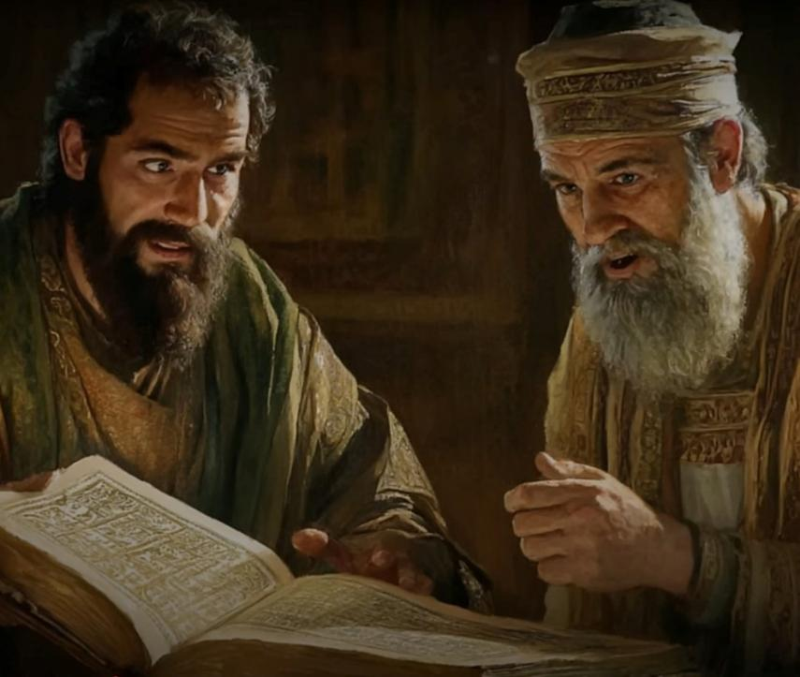
ACTS 17:10-11
And the brethren immediately sent away Paul and Silas by night unto Berea: who coming thither went into the synagogue of the Jews. 11 These were more noble than those in Thessalonica, in that they received the word with all readiness of mind, and searched the scriptures daily, whether those things were so.

Slide 19
ACTS 17:12-15
Therefore many of them believed; also of honourable women which were Greeks, and of men, not a few. 13 But when the Jews of Thessalonica had knowledge that the word of God was preached of Paul at Berea, they came thither also, and stirred up the people. 14 And then immediately the brethren sent away Paul to go as it were to the sea: but Silas and Timotheus abode there still.
15 And they that conducted Paul brought him unto Athens: and receiving a commandment unto Silas and Timotheus for to come to him with all speed, they departed.

Slide 20
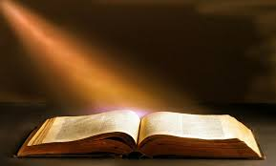
II TIMOTHY 3:14
But continue thou in the things which thou hast learned and hast been assured of, knowing of whom thou hast learned them; 15 And that from a child thou hast known the holy scriptures, which are able to make thee wise unto salvation through faith which is in Christ Jesus.

Slide 21
The Breach
31 I get some of these scriptures, and I think we ought to read them. Many of them I see are writing have got their books and writing the scriptures down - marking them in their Bible... So, that's fine.
I like for you to do that, and then go home and study it. And if you study it yourself, then you'll understand it better. Just study it, and ask God to help you to understand. 63-0317

Slide 22
How to study your bible
Topical Study Topics
Bible Personalities and Events
Historical Studies
Inductive Bible Studies

Slide 23
Inductive Bible Study
An approach to studying God’s Word focusing on three basic steps that move from a focus on specific details to a more general principle. Through these three steps, we apply inductive reasoning, which is defined as the attempt to use information about a specific situation to draw a conclusion. The steps are:
Observation (what does it say?),
Interpretation (what does it mean?),
Application (what does it mean for my life?).

Slide 24
Eg: Inductive bible study
QUESTIONS.AND.ANSWERS.2 54-0103
31 “…Them that are dead in Christ, are free from judgment, and will come forth in the resurrection. But when we die, we go directly into the Presence of Almighty God in a celestial body. If I would meet Bro. Neville up there, I'd say, "Greetings, Bro. Neville.” I couldn't shake his hand; he's in a celestial body. I could talk to him; he'd look just like he does there. But we could talk to one another, but we couldn't touch one another, because we haven't got any of the five senses of see, taste, feel, smell, and hear.

Slide 25
GOD'S.ONLY.PROVIDED.PLACE.OF.WORSHIP
22 It helped me, because I used to have an idea: when a person died, just their soul went off. But then when He quoted that to me, that "If this earthly tabernacle of our habitation be dissolved..." We got to have everything in threes, to make perfection. There's one body here, the celestial, then the glorified body in the resurrection. It's not a myth, not a spirit. It is a man and a woman like you are. …Well, I could feel them. Oh, yes, they have a body. Just not a myth, it's a body. We know one another. They all knowed me, hugging me. 65-1128

Slide 26

Resources

Slide 27
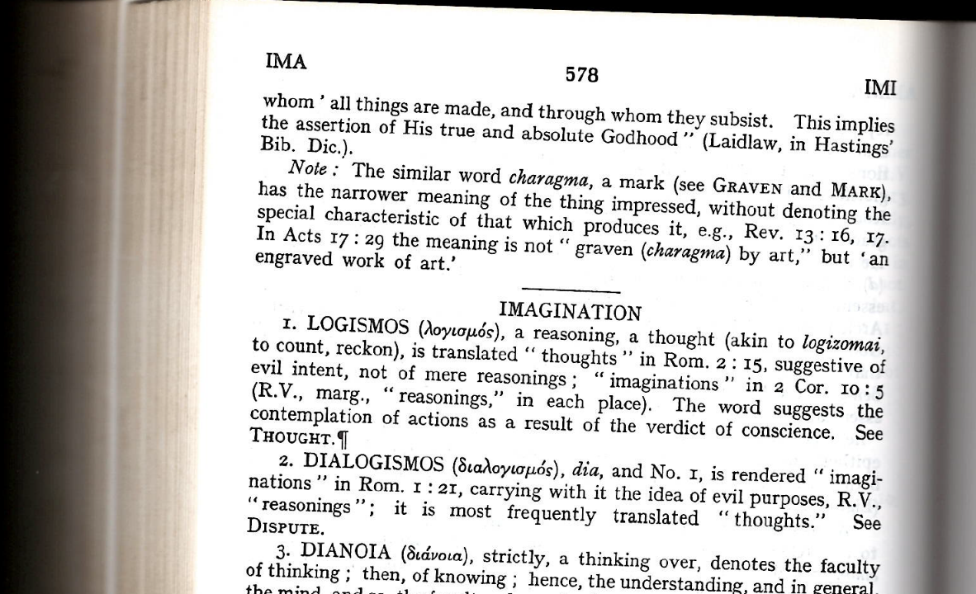

Slide 28
Helpful Links
http://thekingsbible.com/
https://www.biblegateway.com/
https://www.themessagesearch.com/search
https://www.christianbook.com/
https://lifebible.com/features
https://biblestudytogether.com/top-best-bible-reading-plans/
https://messagehub.info/en/messages.do

