Slide 1

The Spirit Controlled Church
EPHESIANS 5:18-21
And be not drunk with wine, wherein is excess; but be filled with the Spirit; 19 Speaking to yourselves in psalms and hymns and spiritual songs, singing and making melody in your heart to the Lord; 20 Giving thanks always for all things unto God and the Father in the name of our Lord Jesus Christ; 21 Submitting yourselves one to another in the fear of God.

Slide 2

Birthdays
Jan. 2nd Yashwa & Sarah John
Jan. 6th Mike Pritchard
Jan. 9th Grace Brown
Jan. 18th Communion
Feb. 28th Anniversary Meeting

Slide 3
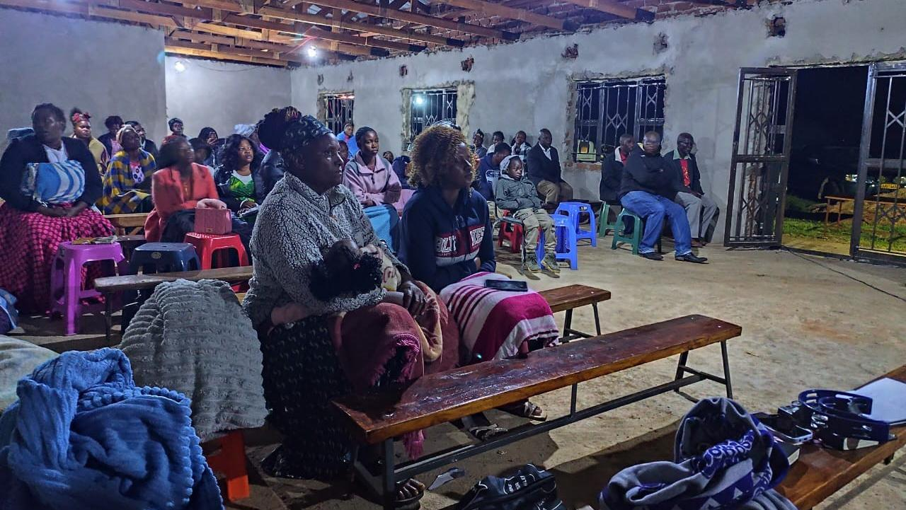

Slide 4
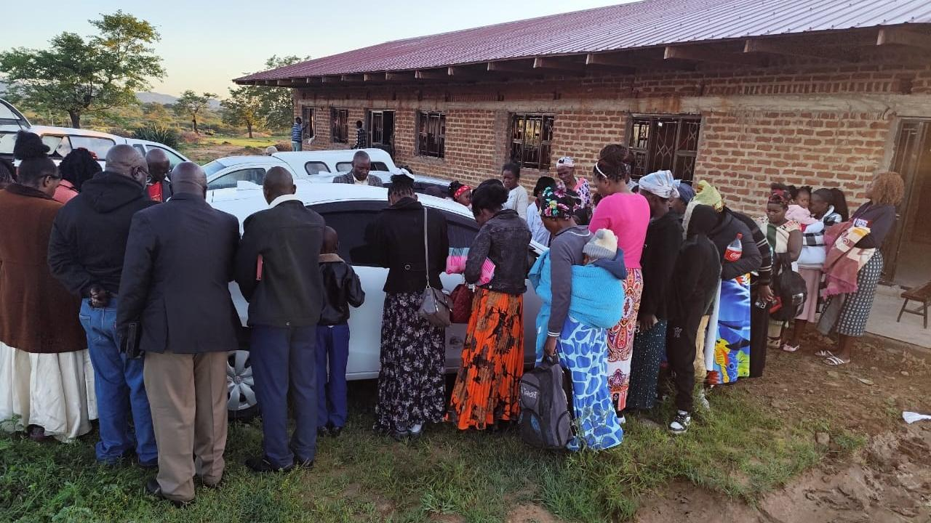

Slide 5
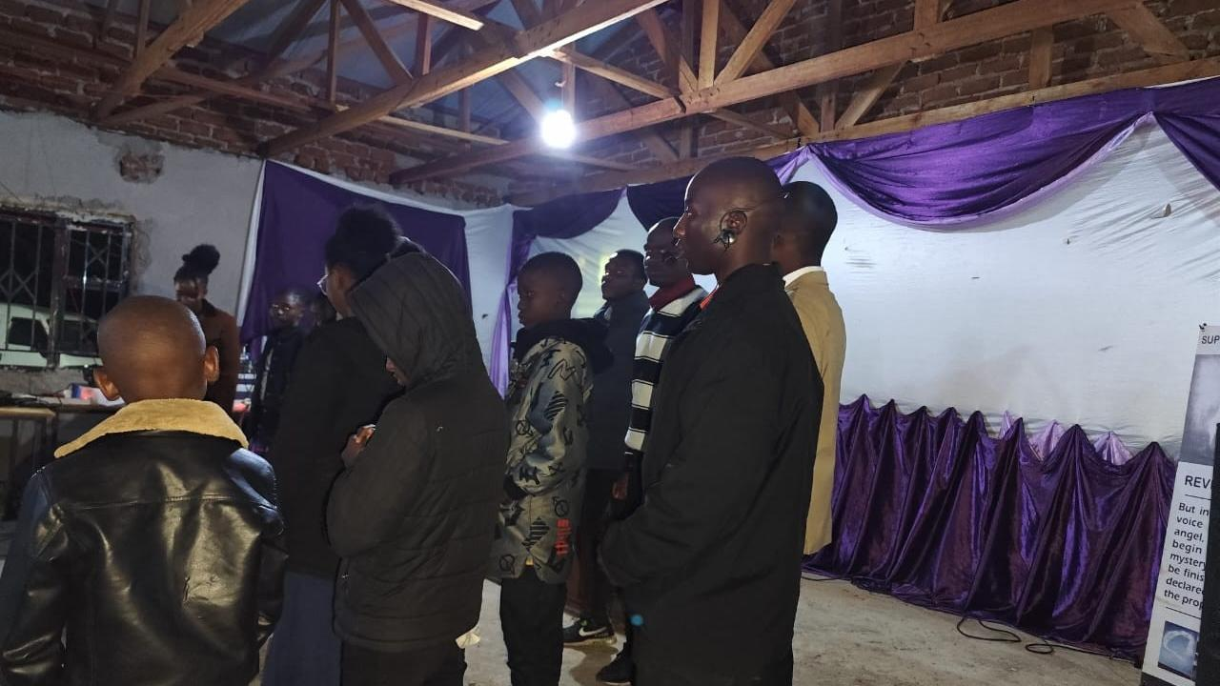

Slide 6
The Spirit Controlled Church
EPHESIANS 5:18-21
And be not drunk with wine, wherein is excess; but be filled with the Spirit; 19 Speaking to yourselves in psalms and hymns and spiritual songs, singing and making melody in your heart to the Lord; 20 Giving thanks always for all things unto God and the Father in the name of our Lord Jesus Christ; 21 Submitting yourselves one to another in the fear of God.

Slide 7
A Glorious Church
EPHESIANS 5:25-27
Husbands, love your wives, even as Christ also loved the church, and gave himself for it; 26 That he might sanctify and cleanse it with the washing of water by the word, 27 That he might present it to himself a glorious church, not having spot, or wrinkle, or any such thing; but that it should be holy and without blemish.

Slide 8
WHEN.DIVINE.LOVE.IS.PROJECTED
SOVEREIGN GRACE.TAKES.ITS.PLACE
7 Be merciful and heal the sick and afflicted. For in this Thou has atoned for at Calvary, and we feel that it is our personal property...
And now, Father, may the Holy Spirit take the Word, open the Book, and loose the power of the Spirit in the Word, and may it find Its resting place in each heart. For we ask it in the Name of Thy beloved Child, the Lord Jesus. Amen. 57-0126

Slide 9
Plus: 1. Healing for the Body
2. Healing for the Spirit
LUKE 17:20-21
And when he was demanded of the Pharisees, when the kingdom of God should come, he answered them and said, The kingdom of God cometh not with observation: 21 Neither shall they say, Lo here! or, lo there! for, behold, the kingdom of God is within you. (already among you.)
Revelation from the Father
Body
Spirit
Soul

Slide 10
ISRAEL.AND.THE.CHURCH
43 God's now loosening up the church every-where, getting in order now so He can get into the rapture, got to give it rapturing faith before it can go in the rapture.
The people are in the spirit of the last days, just like they was in the days of Noah, eating, drinking, marrying, giving in marriage, unconcerned, don't care…
53-0326

Slide 11
THE.RESULTS.OF.DECISION
75 Joshua said, "Now, you're going to see the glory of God." For there hung the Pillar of Fire over them... “But don't let it get out of your sight, 'cause you've never passed this way before.“
I believe there's an experience for the Church “…you've never passed this way before.”
To you people tonight, let's move out towards Jordan. God's here leading you. That's what's talking to your heart and telling you to do it, is the Holy Spirit.
55-1008

Slide 12
76 Now, I can see the people as they went marching on. The Angel of God took Jordan first. The Angel of God will lead you every step of the way. Sometimes you think that the trials are hard. God ain't in no hurry. You're the only one that's in a hurry.
God let the Hebrew children go right in the fiery furnace. He let Daniel get right in the lion's den, before He ever come. Just rise up and start walking by faith. "God, I believe you. I'm bound for the promised land. God, You promised it to me, and here I come…”

Slide 13
Then Now
DANIEL 12:9
And he said, Go thy way, Daniel: for the words are closed up and sealed till the time of the end.
REV. 22:10
And he saith unto me, Seal not the sayings of the prophecy of this book: for the time is at hand.

Slide 14
QUESTIONS.AND.ANSWERS.
I Corinthians 13 says this: "When that which is perfect is come, that which is in part shall be done away with." So all these little things of jumping up-and-down like a kid, trying to talk in tongues, and all these other things, when that which is perfect... And we do have today, by God's help, the perfect interpretation of the Word with Divine vindication. Then that which is in part is done away with. 64-0823

Slide 15
LUKE 5:17-26
And it came to pass on a certain day, as he was teaching, that there were Pharisees and doctors of the law sitting by, which were come out of every town of Galilee, and Judaea, and Jerusalem: and the power of the Lord was present to heal them. 18 And, behold, men brought in a bed a man which was taken with a palsy: and they sought means to bring him in, and to lay him before him.

Slide 16
ACTS 5:34
Then stood there up one in the council, a Pharisee, named Gamaliel, a doctor of the law, had in reputation among all the people, and commanded to put the apostles forth a little space; 35 And said unto them, Ye men of Israel, take heed to yourselves what ye intend to do as touching these men. 36 For before these days rose up Theudas, boasting himself to be somebody; to whom a number of men, about four hundred, joined themselves: who was slain; and all, as many as obeyed him, were scattered, and brought to nought.

Slide 17
THE.TOKEN
24 I am looking for a time of a break forth, of the Spirit of God, in these last days that we're now living in; for another surge of the Holy Spirit, into the Church; for a rapturing faith, just before it comes. And everything is sitting straight in order for that.
And I believe that we're now at the time that the Word should have preeminence. 63-1128

Slide 18
BUT.IT.WASN'T.SO.FROM.THE.BEGINNING
104 Jesus Christ, stands not two foot from where I am now, same Light. And I take every spirit in here under the control of the Holy Ghost for the glory of God. Be quiet. Don't move, because demons go from one to another. And we know that.
If you won't come then say nothing evil against it from henceforth 'cause you'll be blaspheming the Holy Ghost and send your soul to torment without mercy.
61-0411

Slide 19
EPHESIANS 5:18-21
And be not drunk with wine, wherein is excess; but be filled with the Spirit; 19 Speaking to yourselves in psalms and hymns and spiritual songs, singing and making melody in your heart to the Lord; 20 Giving thanks always for all things unto God and the Father in the name of our Lord Jesus Christ; 21 Submitting yourselves one to another in the fear of God.

Slide 20
TITUS 1:6
If any be blameless, the husband of one wife, having faithful children not accused of riot [prodigality] or unruly.

Slide 21
CHRIST.IS.IDENTIFIED.THE.SAME
IN.ALL.GENERATIONS
71 He's Eternal, and He's the only source of Eternal Life… Now, therefore, if we have Eternal Life, we have part of God in us... Then, that's the only way you could have Eternal Life. It isn't something that was manufactured, then given to you by some creed, or you lived into it, you grew into a better man or a better woman.
It's God Himself in you. Just like you're a part of your father here on earth; you're a part of your Heavenly Father.
64-0415

Slide 22
How could this
be possible?
“For the Holy Ghost is Jehovah in Spirit form in you.”

Slide 23
SPIRITUAL.AMNESIA
29 You must be identified… either in Christ or out of Christ. You are not halfway. There's no such a thing as a drunk sober man.
You're either a saved, or you're not saved. You're a saint or a sinner, one or the other. And your spiritual attitude towards God's Word identifies you, exactly where you're standing.
64-0411

Slide 24
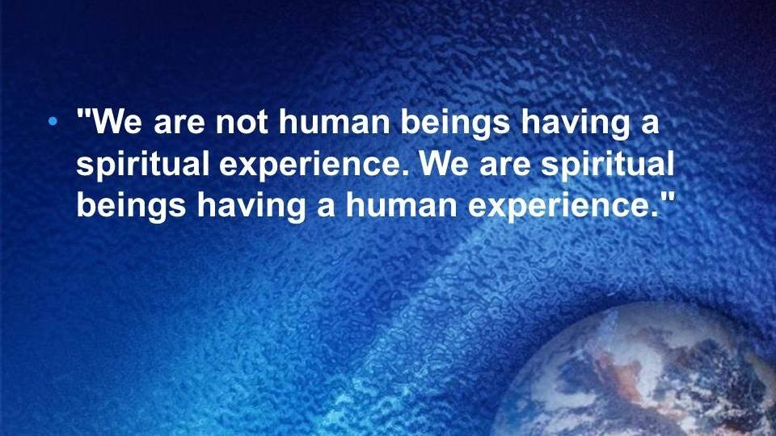

Slide 25
CHURCH.AGE.BOOK
155-1 We have been constantly saying that the true evidence of being baptized with the Holy Ghost is for the believer to receive the Word for the age in which he lives.
In every single age, it says "... He that hath an ear, let him hear what the Spirit saith to the churches." Notice here that Jesus in EVERY age addresses Himself to ONLY ONE person relative to the Word for that age. Only ONE messenger for each age receives what the Spirit has to say to that age. He speaks for God by revelation to the "churches", both true and false.

Slide 26
The message is then broadcast to all. But though it is broadcast for all who come within range of the message, that message is received individually by only a certain qualified group in a certain way. Each individual of that group is one who has the ability to hear what the Spirit is saying by way of the messenger. Those who hear are not getting their own private revelation, nor is a group getting their collective revelation, BUT EACH PERSON IS HEARING AND RECEIVING WHAT THE MESSENGER HAS ALREADY RECEIVED FROM GOD.

Slide 27
QUESTIONS.AND.ANSWERS.2
318. What is the evidence that a person is really filled with the Holy Ghost?
John 14:26: "When the Holy Ghost is come, He will show you things to come." When He the Holy Ghost is come, He will identify Himself in you with the Scripture. And that is the true sign that the Holy Spirit is in you, because It is the Word.
What if you spoke with tongues? I just want to ask you that. Jesus said when the Holy Ghost come

Slide 28
what He would do. What if you spoke with tongues, jumped up-and-down, shouted, then come to the Word; and I'd prove to you by the Scripture, that the baptism using the title of Father, Son, and Holy Ghost is absolutely a misunderstanding in the Scripture; nobody was ever baptized like that, and you go ahead and hang with it anyhow?
Could you tell me the Holy Spirit in you would do a thing like that? How can It deny It's own Word?
64-0823

Slide 29
What are the characteristics
of that Church?

Slide 30

The "test" for spiritual experiences:
If someone claims the Spirit told them to do something that violates a Biblical command (like being dishonest), they can be sure it was not the Spirit of truth, because the Spirit always aligns with God's revealed truth.

Slide 31
THE.GREAT.COMING.REVIVAL 54-0718
33 Today, we're trying to run to this church and say, "Is this got the message?" Over here... "Has this got the message? Look, the Holy Spirit, when He has come, He will lead and guide you into all Truth and will show you things to come. That's the sign of the church today. Watch where the Holy Spirit's a moving. Where the Holy Spirit's moving, you'll find love, joy, peace, signs, and wonders. The power of God amongst His people like this, will be showing signs and wonders of the resurrection of Jesus Christ. Jesus said, "The things that I do, shall you do also..." And you'll see the things that Jesus did will be accompanying that group of people.

Slide 32
LUKE 5:17-20, *26, to 39
And it came to pass on a certain day, as he was teaching, that there were Pharisees and doctors of the law sitting by, which were come out of every town of Galilee, and Judaea, and Jerusalem: and the power of the Lord was present to heal them. 18 And, behold, men brought in a bed a man which was taken with a palsy: and they sought means to bring him in, and to lay him before him. 19 And when they could not find by what way they might bring him in because of the multitude, they went upon the housetop, and let him down through the tiling with his couch into the midst before Jesus. 20 And when he saw their faith, he said unto him, Man, thy sins are forgiven thee.

Slide 33


Slide 34
ACTS 5:33-42
When they heard that, they were cut to the heart, and took counsel to slay them. 34 Then stood there up one in the council, a Pharisee, named Gamaliel, a doctor of the law, had in reputation among all the people, and commanded to put the apostles forth a little space; 35 And said unto them, Ye men of Israel, take heed to yourselves what ye intend to do as touching these men. 36 For before these days rose up Theudas, boasting himself to be somebody; to whom a number of men, about four hundred, joined themselves: who was slain; and all, as many as obeyed him, were scattered, and brought to nought.

Slide 35

“…at evening time it shall be light.”
I JOHN 1:7
But if we walk in the light, as he is in the light, we have fellowship one with another, and the blood of Jesus Christ his Son cleanseth us from all sin.

